Slide 1

Rise and Shine Ceremony
OCTOBER
Year 4

Slide 2

The Pledge of Allegiance:
I pledge allegiance to the flag of the United States of America,
and to the republic for which it stands,
one nation under God,
indivisible,
with liberty and justice for all.

Slide 3
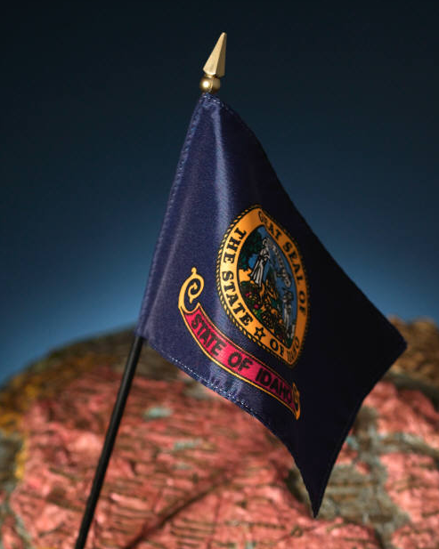
Idaho State Pledge:
I pledge allegiance to the flag of the great State of Idaho.
A land of freedom and opportunity;
I promise to honor and preserve,
its people, its lands and its ideals.

Slide 4

National Anthem:
“The Star-Spangled Banner”
Instrumental
Vocal
Verse 1:
O! say can you see by the dawn's early light
What so proudly we hailed
at the twilight's last gleaming?
Whose broad stripes and bright stars
thru the perilous fight,
O'er the ramparts we watched
were so gallantly streaming?
And the rocket's red glare, the bombs bursting in air,
Gave proof through the night that our flag was still there.
Oh, say does that star-spangled banner yet wave
O'er the land of the free and the home of the brave?
Verse 2:
On the shore, dimly seen through the mists of the deep,
Where the foe's haughty host in dread silence reposes,
What is that which the breeze, o'er the towering steep,
As it fitfully blows, half conceals, half discloses?
Now it catches the gleam of the morning's first beam,
In full glory reflected now shines in the stream:
'Tis the star-spangled banner! Oh long may it wave
O'er the land of the free and the home of the brave!
Verse 3:
And where is that band who so vauntingly swore,
That the havoc of war and the battle’s confusion,
A home and a country should leave us no more!
Their blood has washed out their foul footsteps’ pollution.
No refuge could save the hireling and slave
From the terror of flight, or the gloom of the grave;
And the star-spangled banner in triumph shall wave
O’er the land of the free and the home of the brave!
Verse 4:
O! thus be it ever, when freemen shall stand
Between their loved home and the war's desolation!
Blest with victory and peace,
may the heav'n rescued land
Praise the Power that hath made and preserved us a nation.
Then conquer we must, when our cause it is just,
And this be our motto: "In God is our trust.“
And the star-spangled banner in triumph shall wave
O'er the land of the free and the home of the brave!

Slide 5
AHCS Performance Certificate:
Our mission is to create patriotic and educated leaders.
We believe in James Madison’s statement that:
“The advancement and diffusion of knowledge is the only guardian of true liberty.”
To accomplish this we will:
1. Focus on patriotic American values.
2. Build a culture of respect.
3. Provide a rigorous academic education.
4. Support teacher growth and excellence.

Slide 6
School Creed:
I am an American Heritage Charter School Patriot.
I am intelligent and unique.
I am respectful, honest, and kind.
I have high hopes for my future and great expectations for myself.
I promise to be the best I can be using the life principles of our country’s great heroes to guide me.
I promise to enrich the world by serving others.
I am a patriot—strong, proud, and brave!
A leader today and tomorrow.

Slide 7
INSERT*YOUR*CLASS*CREED*HERE*
AHCS

Slide 8
Teacher’s Creed:
I am a teacher.
I accept the challenge to be sagacious and tenacious in teaching every student, because I believe every student can learn.
I accept the responsibility to create a learning environment conducive to optimum achievement academically, socially, and emotionally.
I actively pursue excellence for my students and myself.
I provide a model of decorum and respect that guides my students as well as honors them.
I affirm superlative expectations for my students and myself.
I cherish every student.
I am a teacher.
I change the world one student at a time.

Slide 9
The 8 Expectations for Living
We will value one another as unique and special individuals.
We will not laugh at or make fun of a person’s mistakes nor use sarcasm or putdowns.
We will use good manners, saying “please, thank you, and excuse me” and allow others to go first.
We will cheer each other to success.
We will help one another whenever possible.
We will recognize every effort and applaud it.
We will encourage each other to do our best.
We will practice virtuous living, using the Life Principles.

Slide 10
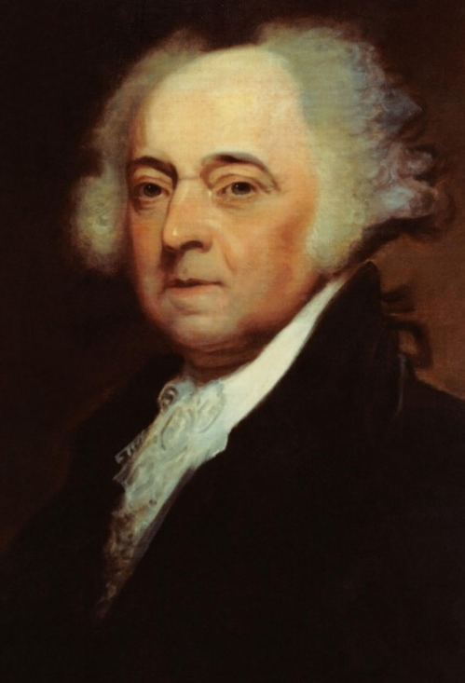
Hero of the Month:
John Adams (1735 – 1826)
American lawyer, author, statesman, and diplomat.
First Vice President and 2nd President of the United States of America.
Assisted Thomas Jefferson in drafting the Declaration of Independence.
As a diplomat to Europe, Adams negotiated the peace treaty with Great Britain that ended the Revolutionary war.
Promoted republicanism and a strong central government.

Slide 11
Quote of the Month:
“Let us tenderly and kindly cherish, therefore, the means of knowledge. Let us dare to read, think, speak, and write.”
~John Adams

Slide 12
Life Principle of the Month:
initiative
Seeing what needs to be done, and doing it.

Slide 13
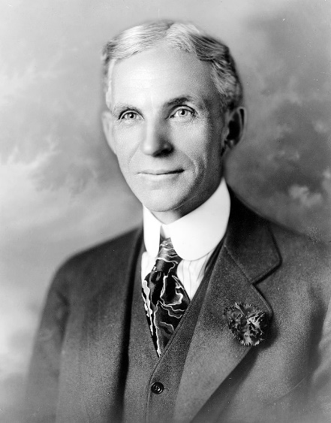
Supplemental Hero of the Month:
Henry Ford (1863 - 1947)
American industrialist, and founder of the Ford Motor Co.
still in operation today.
Sponsored the development of the “assembly line technique” for mass production.
Designed the first automobile that most Americans could afford.
His “Model T Ford” automobile revolutionized the transportation industry.
At the time of his death, Henry Ford was one of the richest and most well-known people in the world.

Slide 14

Song of the Month:
“This Land Is Your Land”
Instrumental
Vocal
This land is your land, this land is my land
From California, to the New York Island
From the redwood forest, to the gulf stream waters
This land was made for you and me
As I was walking a ribbon of highway
I saw above me an endless skyway
I saw below me a golden valley
This land was made for you and me
I've roamed and rambled and I've followed my footsteps
To the sparkling sands of her diamond deserts
And all around me a voice was sounding
This land was made for you and me
This land is your land, this land is my land
From California, to the New York Island
From the redwood forest, to the gulf stream waters
This land was made for you and me

Slide 15
Verse of the Month:
“The Guy in the Glass” by Dale Wimbrow
When you get what you want in your struggle for *pelf,
And the world makes you King for a day,
Then go to the mirror and look at yourself,
And see what that guy has to say.
For it isn't your Father, or Mother, or Wife,
Whose judgment upon you must pass.
The feller whose verdict counts most in your life
Is the guy staring back from the glass.
He's the feller to please, never mind all the rest,
For he's with you clear up to the end,
And you've passed your most dangerous, difficult test
If the guy in the glass is your friend.
*pelf noun: money, riches
“Pelf.” Merriam-Webster.com Dictionary, Merriam-Webster, https://www.merriam-webster.com/dictionary/pelf. Accessed 1 Oct. 2020.

Slide 16
Verse of the Month: continued
You may be like Jack Horner and “chisel” a plum,
And think you're a wonderful guy,
But the man in the glass says you're only a bum
If you can't look him straight in the eye.
You can fool the whole world down the pathway of years,
And get pats on the back as you pass,
But your final reward will be heartaches and tears
If you've cheated the guy in the glass.

Slide 17
Words of the Month:
ambition
A strong desire to do or achieve something.
creativity
The use of the imagination or use of original ideas.
capitalism
An economic and political system in which a country’s trade and industry is controlled by private owners for profit, rather than by the state.
rigor
The quality of being extremely thorough, exhaustive, or accurate.

Slide 18
Bill of Rights
Amendment II
A well regulated Militia, being necessary to the security of a free State, the right of the people to keep and bear Arms, shall not be infringed.

Slide 19
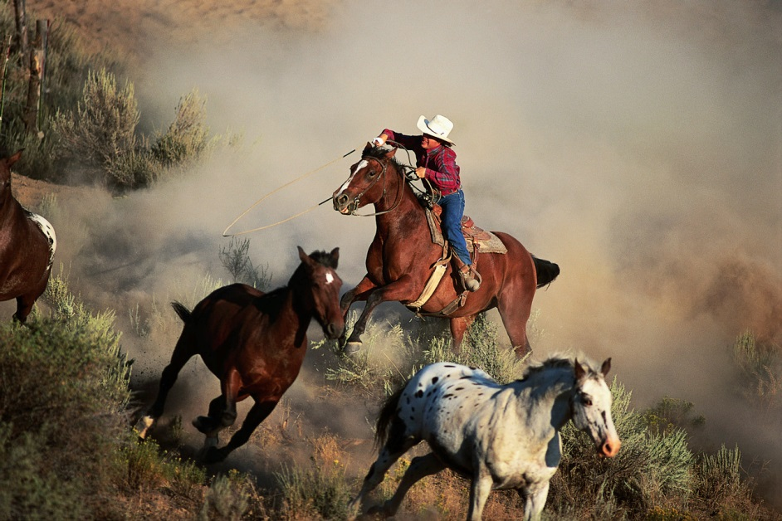
Cowboy Ethics by James P. Owen
2: Take pride in your work.

Slide 20
Virtual Friday Home-to-School Connection
Week 1:
View the PowerPoint as a family, or on your own, and send your teacher an email sharing your favorite part of this month’s AHCS curriculum.
Weeks 2 – 4: Choice Board
Virtual Friday Home-To-School Connection CHOICE BOARD Choose One Activity PER WEEK From the Options Below
Great Expectations | Cowboy Ethic | Words of the Month | Verse of the Month | Life Principle of the Month
We will not laugh at or make fun of a person’s mistakes, nor use sarcasm or putdowns. Listen to the story, “BE KIND” by Pat Zietlow Miller and Jen Hill. https://youtu.be/t6NUJ2JZz50 Come up with a Be Kind Project brainstorming with ideas from the story Post pictures of your acts of kindness with #AHCSStands on the AHCS Facebook page. | Take pride in your work. Complete an act of service for someone else and take pride in completing it well. | One of our words this month is creativity. Creativity means using your imagination or original ideas. Use your creativity to make something unique. It could be an art project, building something, or anything else that uses your imagination. | “The Guy in the Glass” by Peter Dale Wimbrow, Sr. This poem is about being honest with yourself, don’t just believe what others say about you. Draw a self-portrait and label it with the positive things you see in yourself. | Our life principle of the month is initiative. Initiative is seeing that something needs to be done, and doing it. Learn more about our Life Principle Initiative by watching this video by Rocket Kids. https://www.youtube.com/watch?v=ALtsSru4jzE&ab_channel=RocketKids

Slide 21
Birthdays
and
Announcements

Slide 22
Essential 55 by Ron Clark
Rule 7:
When you cough, or sneeze, or burp, it is appropriate to turn your head away from others and cover your mouth with the full part of your hand. Using a fist is not acceptable. Afterward, you should say, “Excuse me.”
Rule 8:
Do not smack your lips, tsk, roll your eyes, or show disrespect with gestures.
Rule 9:
Always say thank you when I give you something. If you do not say it within 3 seconds after receiving the item, I will take it back. There is no excuse for not showing appreciation.

Slide 23
Essential 55 by Ron Clark continued
Rule 10:
When you are given something from someone, never insult that person by making negative comments about the gift or by insinuating that it wasn’t appreciated.
Rule 11:
Surprise others by performing random acts of kindness. Go out of your way to do something surprisingly kind and generous for someone at least once a month.
Rule 12:
Occasionally we may grade each other’s papers as a group. When grading other students’ papers, if you give someone an incorrect grade, whether it is higher or lower than they deserve, the amount of the grade differs from the actual grade will be deducted from your paper. The only marks you are allowed to make on others’ papers are an “X” and the number they got incorrect.

Slide 24
George Washington’s Rules of Civility:
#85: In Company of these Higher Quality than yourself Speak not til you are asked a Question then Stand upright put of your Hat & Answer in few words.
#86: In Disputes, be not So Desirous to Overcome as not to give Liberty to each one to deliver his Opinion and Submit to the Judgment of the Major Part especially if they are Judges of the Dispute.
#87: Let they carriage be such as becomes a Man Grace Settled and attentive to that which is spoken. Contradict not at every turn what others Say.

